Slide 1
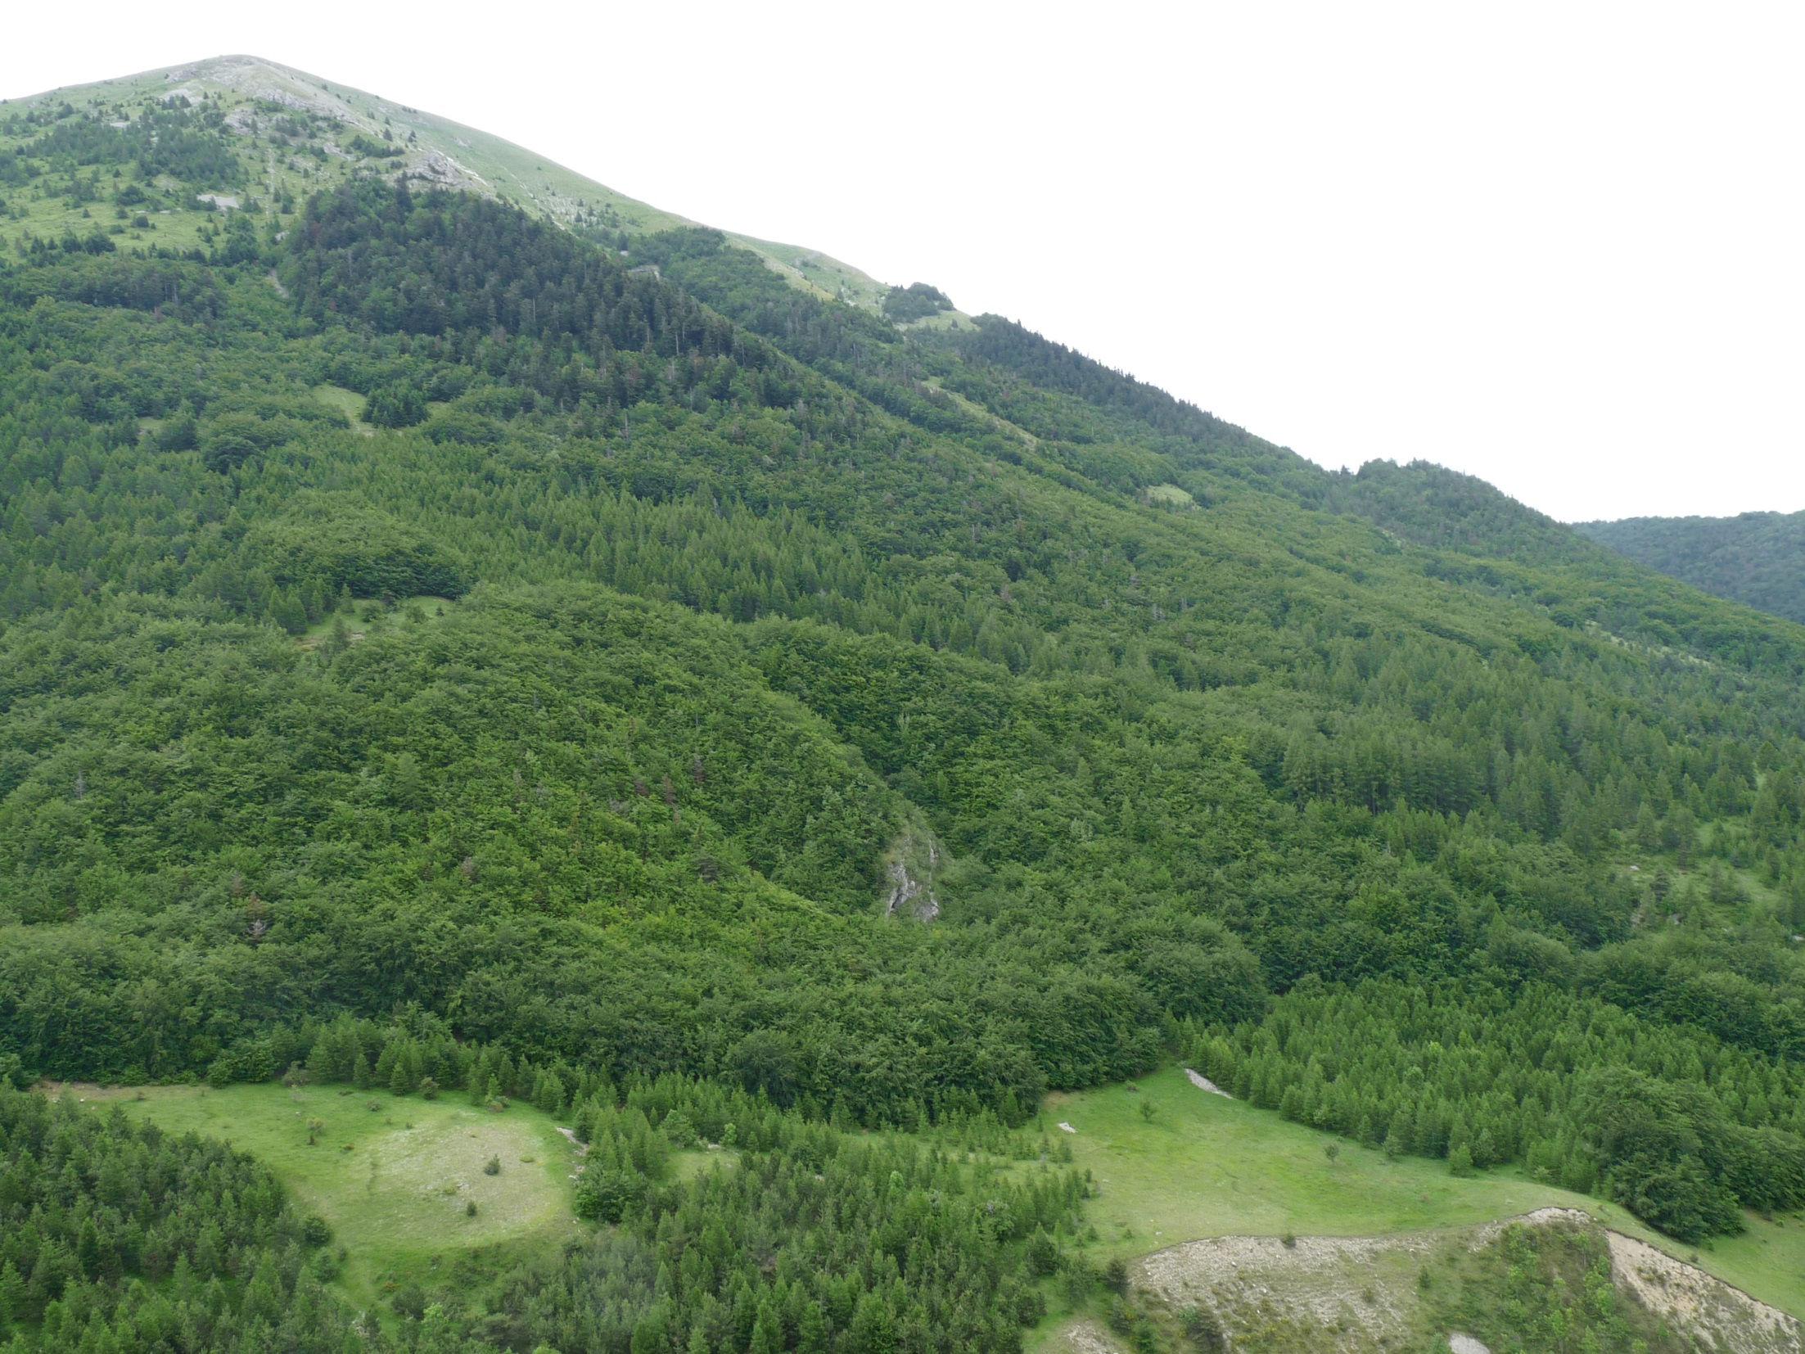




Analyse des processus régissant l’assemblage des communautés par une approche de modélisation mécaniste
Using a process-based forest model to understand how environmental conditions and competition affect community assembly
Mickael Chauvet
Supervisors:
Jacques Roy (ECOTRON)
Xavier MORIN (CEFE)

Slide 2
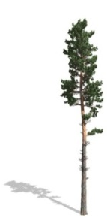
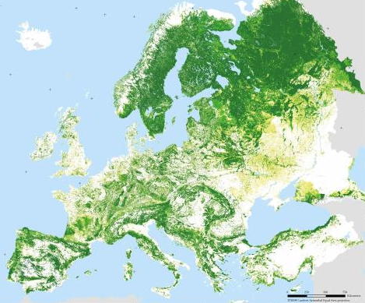
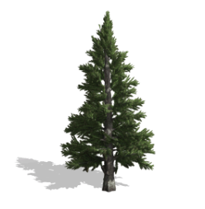
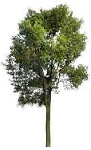
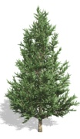


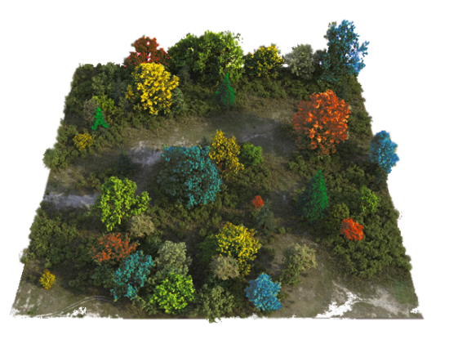
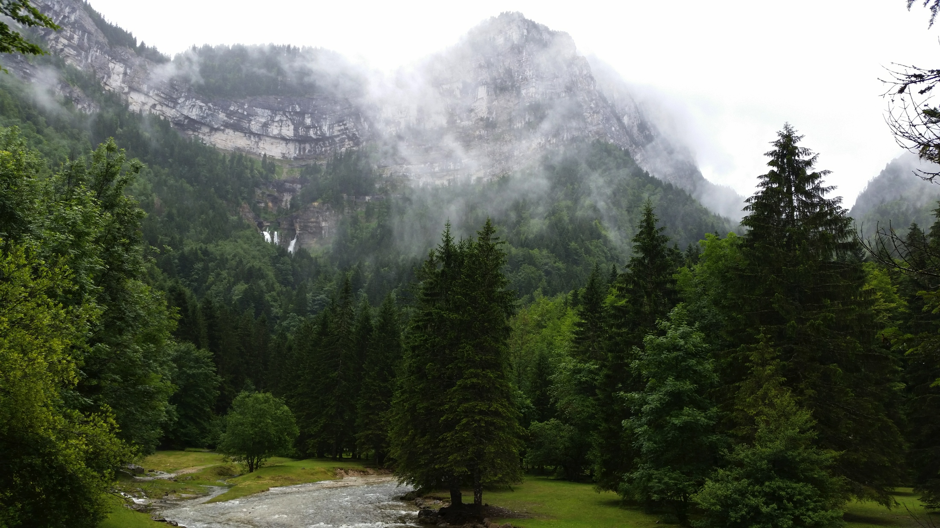
²
Forest community assembly
Regional species pool
?
Local community

Slide 3
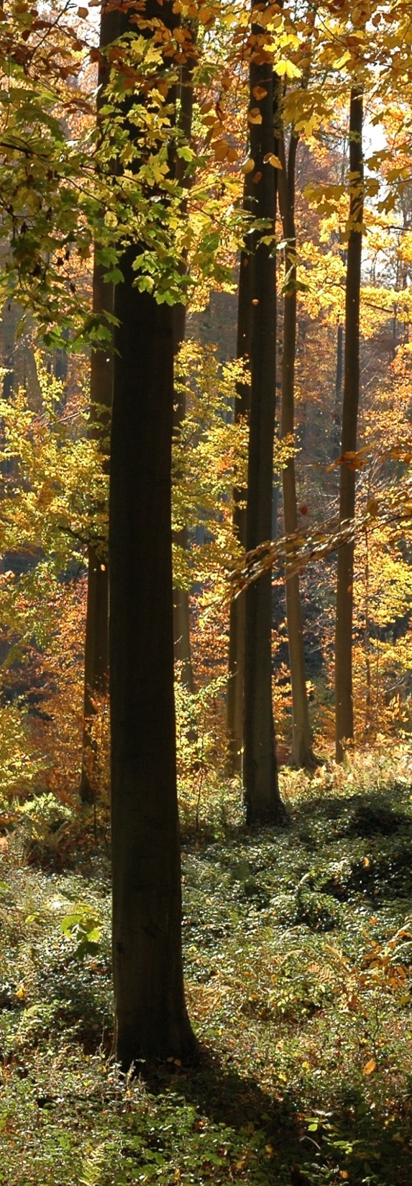




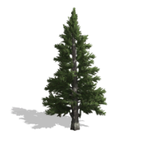





²
Community assembly processes
Regional pool
Local pool
Local community

Slide 4
²
Community assembly processes
Regional pool
Environmental filtering
Local pool
Local community
Weiher & Keddy 1995

Slide 5
²
Community assembly processes
Regional pool
Environmental filtering
Local pool
Competition
Local community
Tilman 1987

Slide 6
²
Community assembly processes
Regional pool
?
Environmental filtering
Functional Diversity
Local pool
?
Competition
Local community

Slide 7
²
Community assembly processes
Range
Regional pool
Frequency
?
Environmental filtering
Trait axis
Kraft, Valencia & Ackerly 2008
Local pool
Divergence
?
Competition
Frequency
Convergence
Trait axis
Frequency
MacArthur & Levins 1967
Local community
Trait axis
Mayfield & Levine 2010

Slide 8
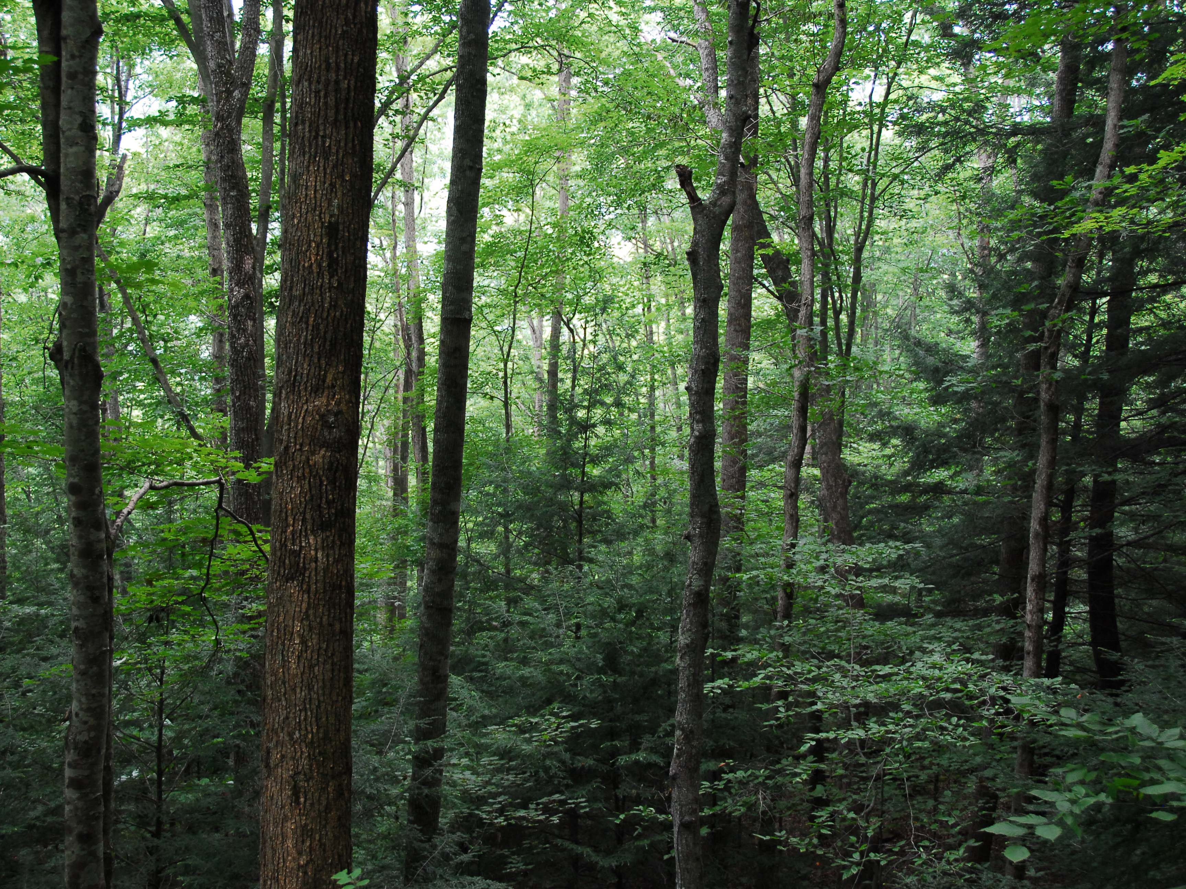
How do environmental conditions and competition shape forest communities composition?

Slide 9
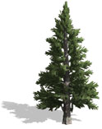


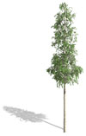





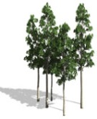


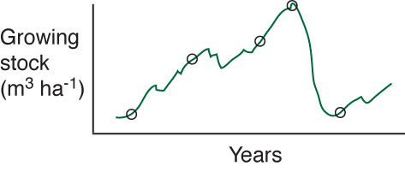









²
Forest-gap model: an original tool
FORCLIM
Bugmann 2001
FORests in changing CLIMate
Environmental filtering
Competition

Slide 10
²
Forest-gap model: an original tool
FORCLIM
Bugmann 2001
FORests in changing CLIMate

Slide 11
²
Forest-gap model: an original tool
FORCLIM
Light competition
1
Bugmann 2001

Slide 12
²
Forest-gap model: an original tool
FORCLIM
Light competition
1
Bugmann 2001
Temperature
Drought Stress
Soil Nitrogen
2

Slide 13
²
Forest-gap model: an original tool
FORCLIM
Light competition
1
Bugmann 2001
Temperature
Drought Stress
Soil Nitrogen
2
30 European tree species
3
(Interspecific variability)

Slide 14
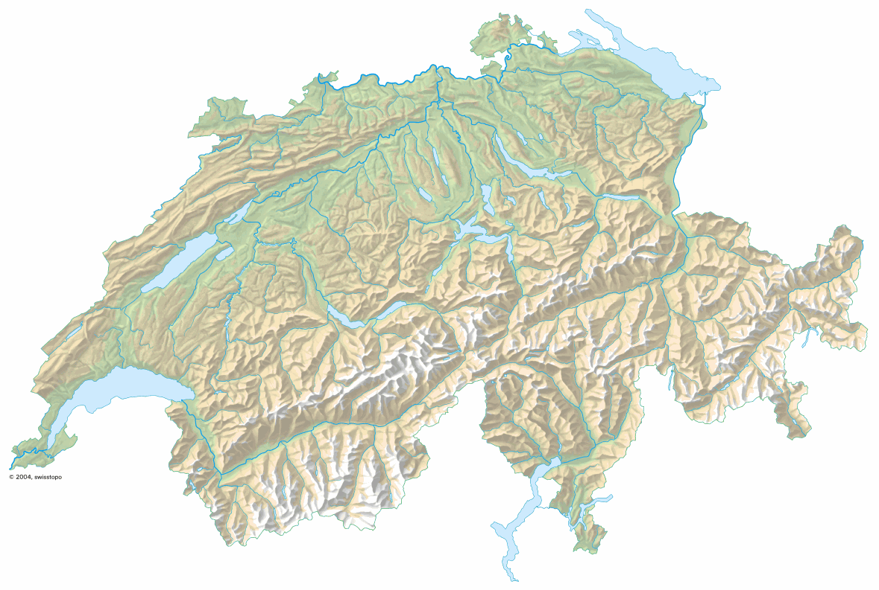
²
Forest-gap model: an original tool
FORCLIM
Light competition
1
Bugmann 2001
+ 2 sites in Germany
Schwerin
Schaffhausen
Cottbus
Basel
Temperature
Drought Stress
Soil Nitrogen
2
Huttwil
Bern
SWITZERLAND
Davos
Bever
Adelboden
30 European tree species
Sion
3
G^{de} Dixence
Bugmann 1996
Didion et al. 2009
Validation in situ
Validation in situ
4

Slide 15
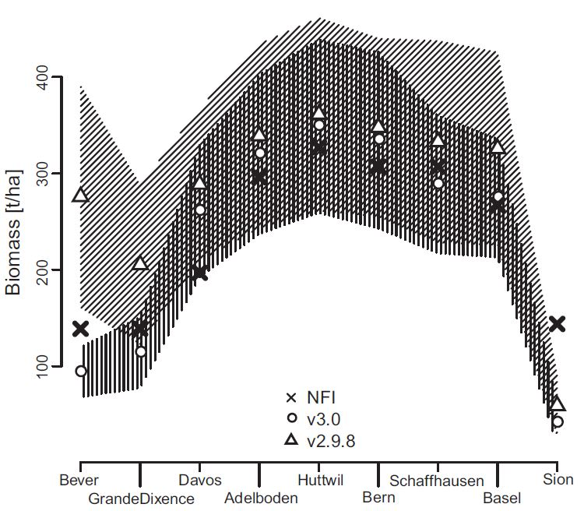
²
Forest-gap model: an original tool
FORCLIM
Light competition
1
Bugmann 2001
Temperature
Drought Stress
Soil Nitrogen
2
30 European tree species
3
Rasche et al. 2012
Re-validated in situ
4

Slide 16
²
Possible outcomes to competition
Competition
FORCLIM
Bugmann 2001

Slide 17
²
Possible outcomes to competition
Competition
FORCLIM
Bugmann 2001
Convergence
Frequency
Trait axis
Competitive dominance of late successional species
Rees et al. 2001

Slide 18
²
Possible outcomes to competition
Competition
FORCLIM
Bugmann 2001
Convergence
Divergence
VS
Frequency
Frequency
Trait axis
Trait axis
Competitive dominance of late successional species
The successional niche
Pacala and Rees 1998
Rees et al. 2001

Slide 19
Forest dynamic simulations

Slide 20




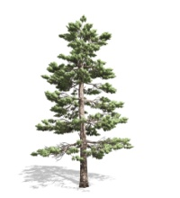

Forest dynamic simulations
Monocultures
Forest succession
2000 years
Local species richness (n)
……
……
……
……

Slide 21












Forest dynamic simulations
Monocultures
Forest succession
2000 years
Local species richness (n)
……
……
……
……
Mixtures
n Species
…
…
2000 years
Realized species richness

Slide 22

Null
communities
FORCLIM
communities
Random trait distribution
Observed trait distribution
VS
Frequency
Frequency
Trait axis
Trait axis

Slide 23
Community response to abiotic conditions
Sites differing on 3 abiotic axes:
Temperature
Precipitation
Soil nitrogen availability

Slide 24
Environmental Filtering
Environmental Trait Filtering
Range reduction
Frequency
Trait axis
Environmental traits
Chauvet et al. under review

Slide 25

Environmental Filtering
Environmental Trait Filtering
Range reduction
Frequency
Trait axis
Environmental traits
Nitrogen requirement
Chauvet et al. under review

Slide 26
Environmental Filtering
Environmental Trait Filtering
Range reduction
Shade Tolerance
Frequency
Trait axis
Environmental traits
Nitrogen requirement
& Biotic traits
Chauvet et al. under review

Slide 27

Competition: trait divergence or convergence?
Shade Tolerance
Maximal Height

Slide 28
Competition: Strong Convergence
Shade Tolerance
Maximal Height
Convergence
High shade tolerance
High maximum height
Frequency
Trait axis
Chauvet et al. under review

Slide 29
Competition: Strong Convergence
Shade Tolerance
Maximal Height
Convergence
Stronger Convergence
High shade tolerance
High maximum height
Frequency
Frequency
Trait axis
Trait axis
Chauvet et al. under review

Slide 30
Competition: Strong Convergence
Shade Tolerance
Maximal Height
Niinemets 2010
Westoby et al. 2002
Convergence
Stronger Convergence
Competitive dominance of late successional species
Frequency
Frequency
Trait axis
Trait axis
Chauvet et al. under review

Slide 31
Part 1 : To sum up
FORCLIM
An alternative approach of virtual experiments
Bugmann 2001
Morin et al. 2011

Slide 32
Part 1 : To sum up
FORCLIM
An alternative approach of virtual experiments
Bugmann 2001
Morin et al. 2011
Multi-species coexistence with light competition
Non-random assembly patterns

Slide 33
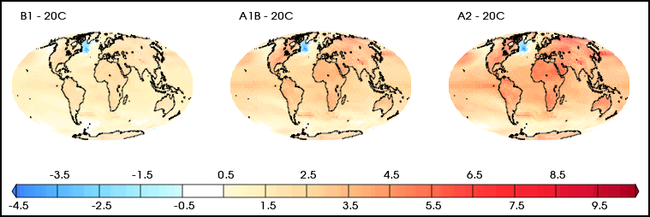
Part 1 : Perspective
FORCLIM
An alternative approach of virtual experiments
Bugmann 2001
Morin et al. 2011
Multi-species coexistence with light competition
What about community assembly under current climate change ?
Non-random assembly patterns

Slide 34
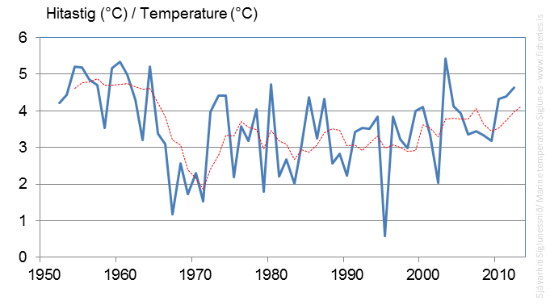
Effects of climate variability for assembly ?
Regional species pool
Temperature (°C)
?
Local community

Slide 35

Effects of climate variability for assembly ?
Regional species pool
Temperature (°C)
?
Local community

Slide 36

How does climate variability affect community assembly and species coexistence ?

Slide 37
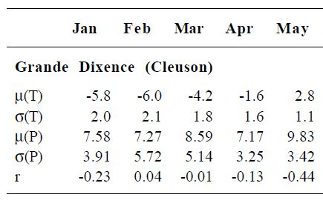
Climatic data used in the model
FORCLIM
Swiss Meteorological Agency (1901 – 1990)
Bugmann 2001
+ 2 sites in Germany
Schwerin
Schaffhausen
Cottbus
Basel
Huttwil
Bern
SWITZERLAND
Davos
Adelboden
Bever
Sion
G^{de} Dixence
Bugmann 1994
Monthly means temperature
Monthly means precipitation sums

Slide 38
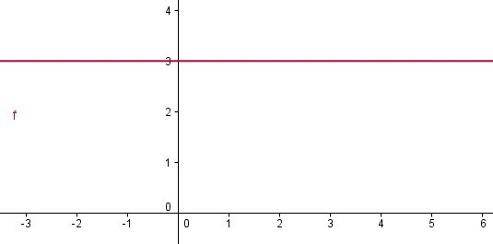
Three different climatic scenarios
Temperature (°C) of May
1 - WITHOUT interannual climate variability

Slide 39
Three different climatic scenarios
Temperature (°C) of May
Temperature (°C) of May
1 - WITHOUT interannual climate variability
2 - WITH interannual climate variability

Slide 40
Three different climatic scenarios
Temperature (°C) of May
Temperature (°C) of May
1 - WITHOUT interannual climate variability
2 - WITH interannual climate variability
Temperature (°C) of May
3 – INCREASED interannual climate variability

Slide 41
Forest dynamic simulations
Monocultures
Forest succession
2000 years
Local species richness (n)
……
……
……
……
Mixtures
n Species
…
…
2000 years
Realized species richness

Slide 42
Climate variability and local species pool
Regional pool
Environmental filtering
Local pool

Slide 43
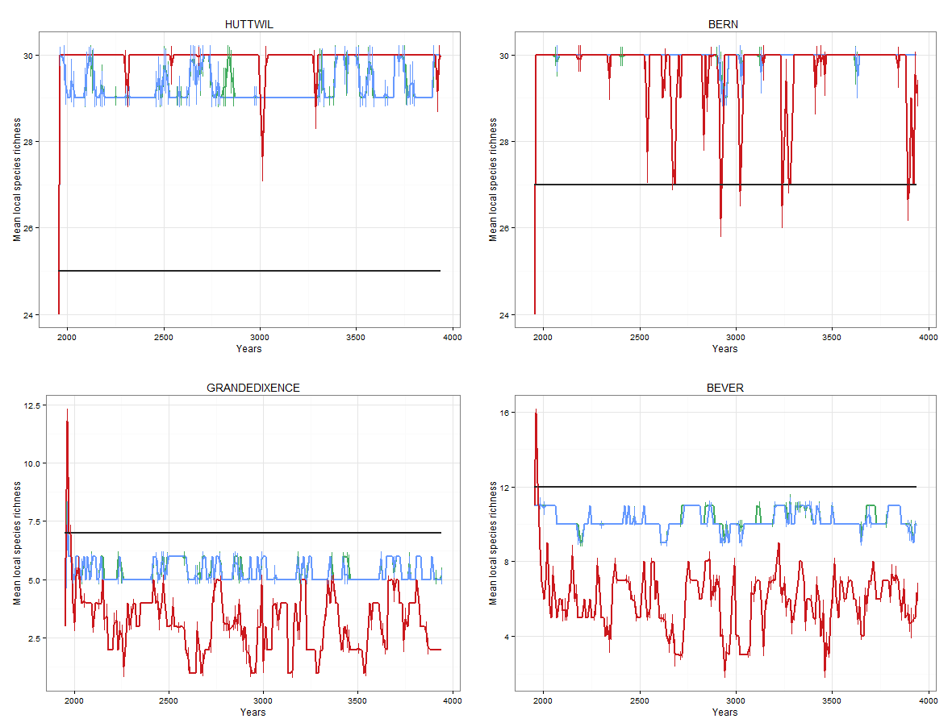
Climate variability and local species pool
Mean local species richness
No clim var
Clim var
Increased clim var

Slide 44
Climate variability and local species pool
Mean local species richness
No clim var
Clim var
Increased clim var

Slide 45
Climate variability and realized species richness
Environmental filtering
Competition
Local community

Slide 46
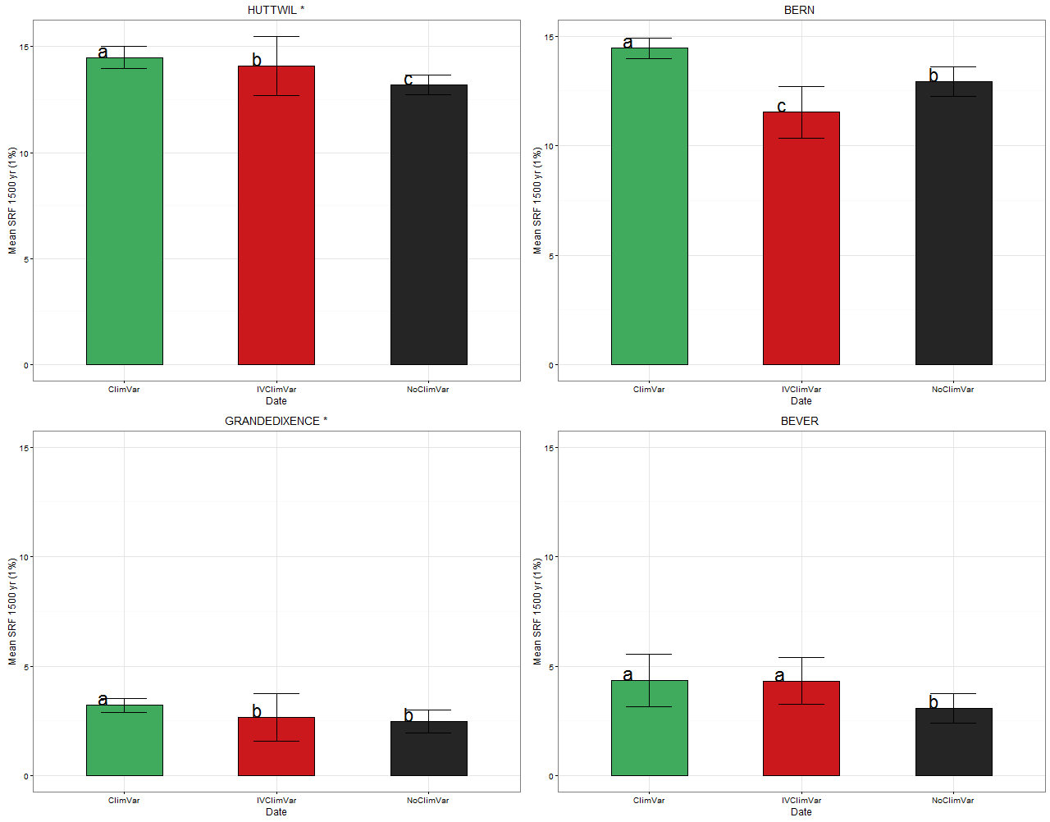
Climate variability and realized species richness
Mean realized species richness
No clim var
Clim var
Increased clim var

Slide 47
Climate variability and realized species richness
Mean realized species richness
No clim var
Clim var
Increased clim var

Slide 48
Climate variability and community composition

Slide 49
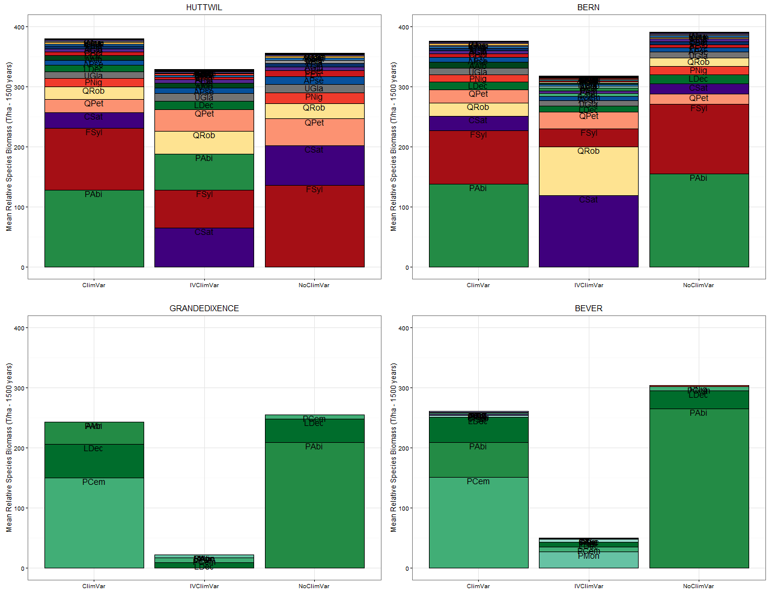
Climate variability and community composition
Relative species biomasses

Slide 50
Climate variability and community composition
Relative species biomasses

Slide 51
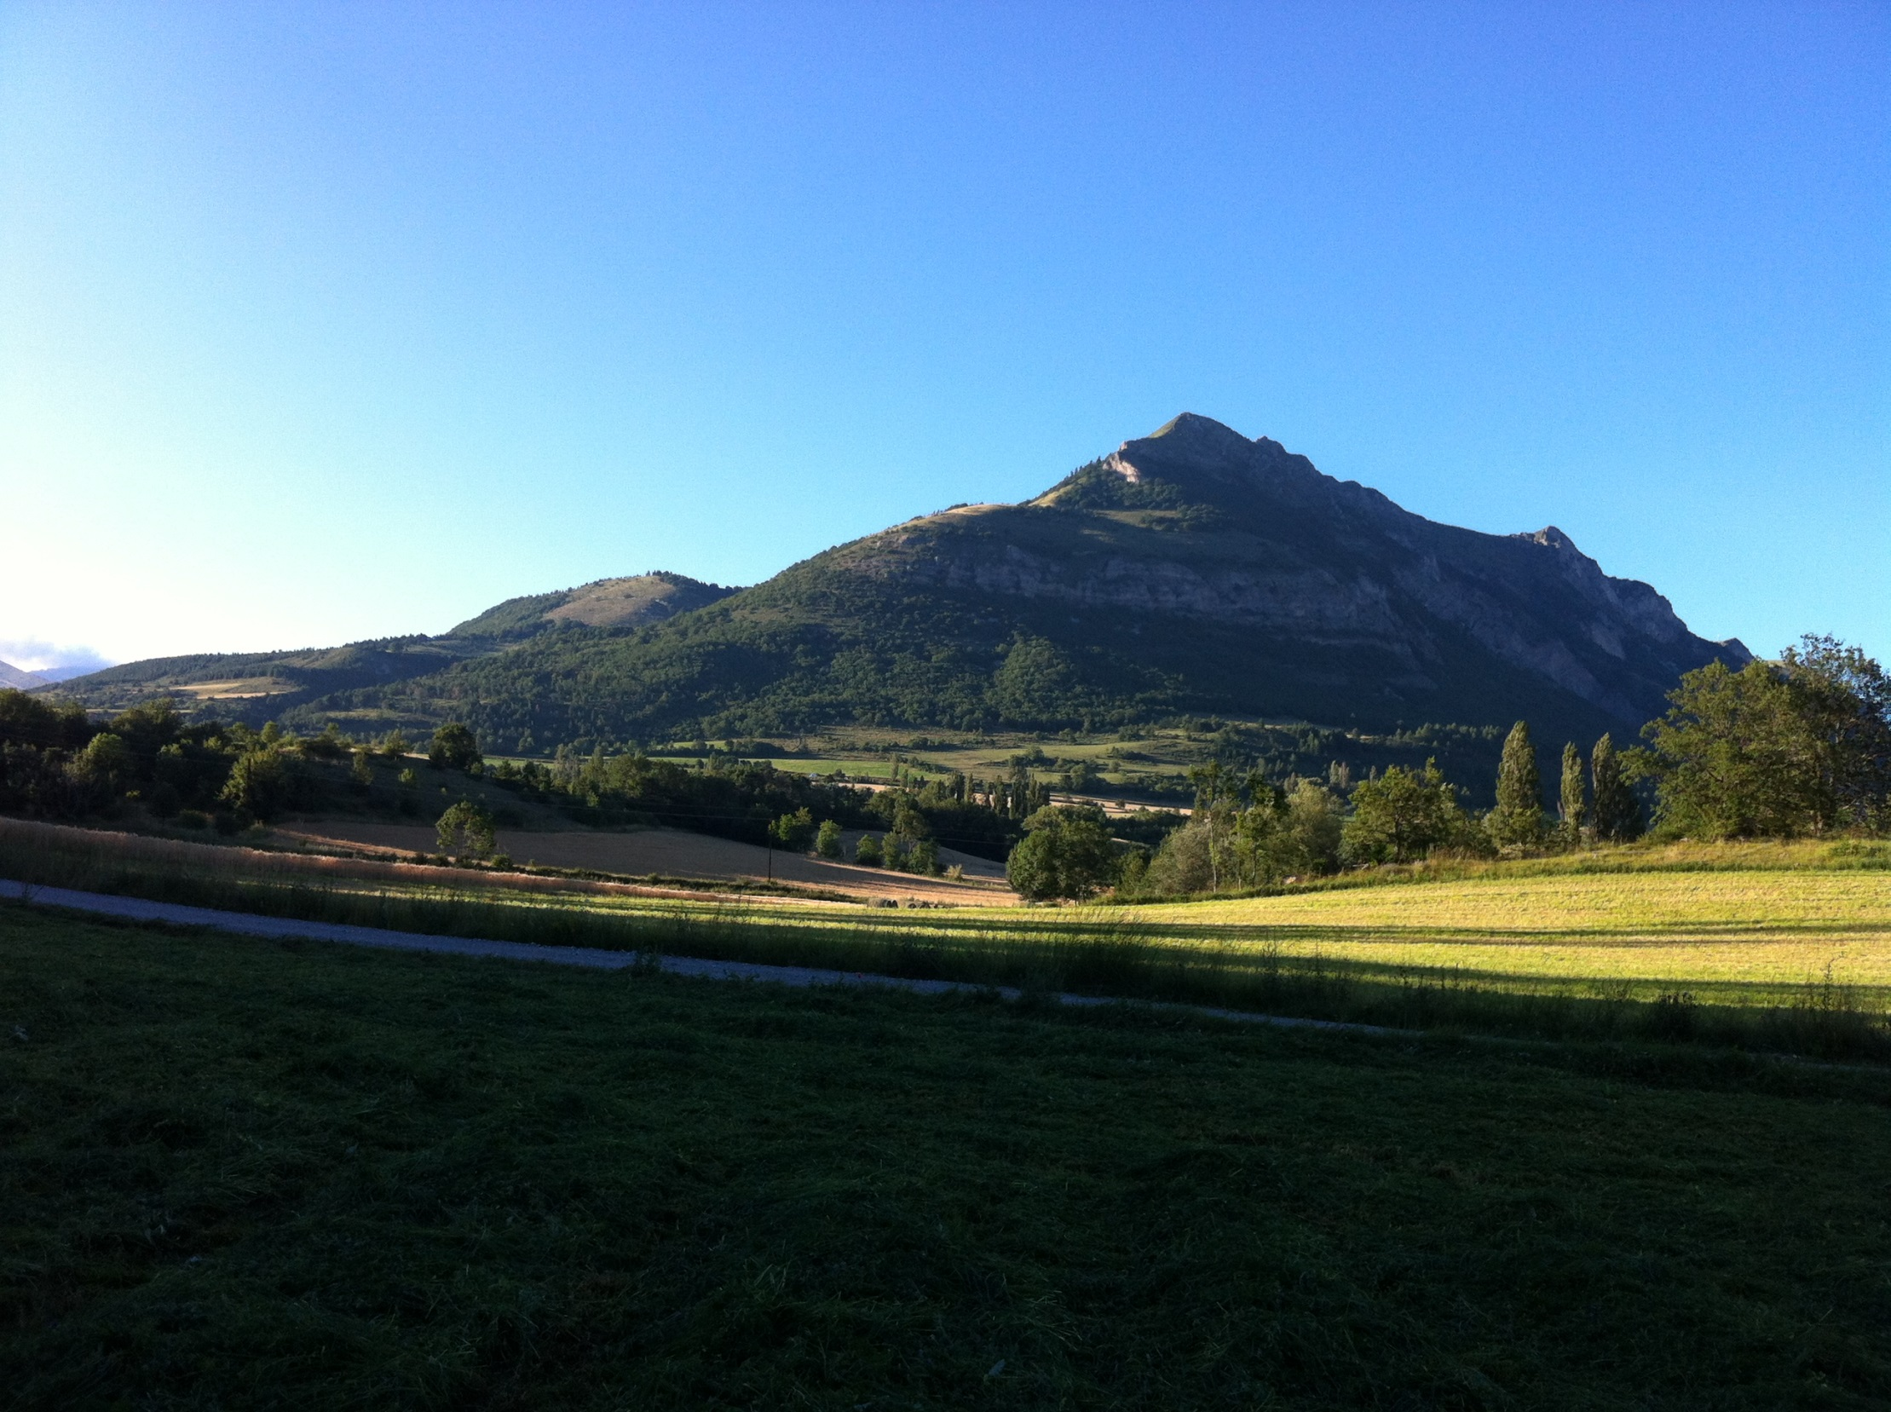
THANKS FOR YOUR ATTENTION !

Slide 52
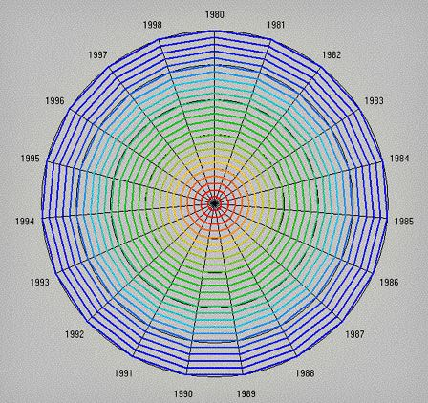
Climate variability and community dynamics
Rank clocks
Collins et al. 2008

Slide 53
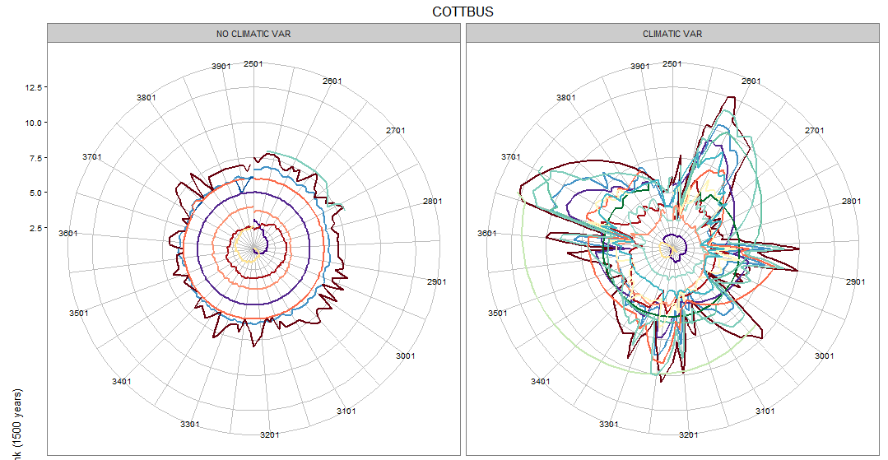
Climate variability and community dynamics
SR = 7
SR = 7

Slide 54
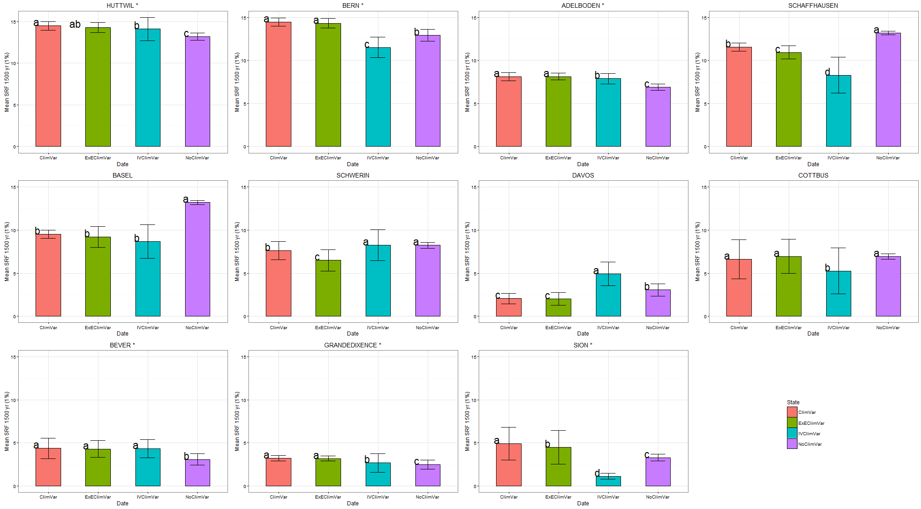
Climate variability and realized species richness
7/11 -> positive effect of the climate variability (CV or ICV) for realized Sp Richness

Slide 55
Climate variability and maximal species richness

Slide 56
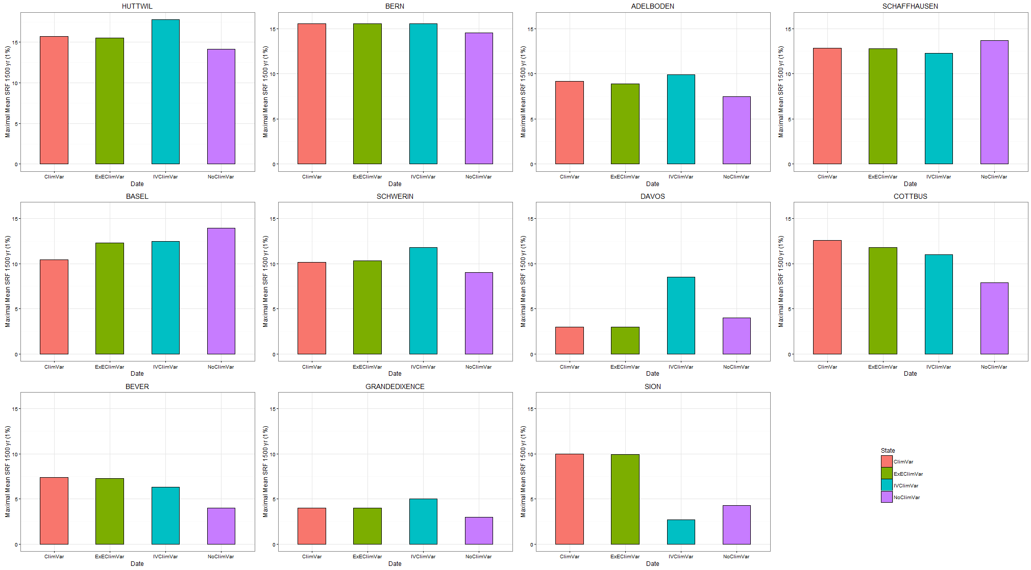
Climate variability and maximal species richness
9/11 -> positive effect of the climate variability for maximal Sp Richness

Slide 57
Effects of climate variability on :

Slide 58
Effects of climate variability on :
Regional pool
1 – Local species pool ?
Environmental filtering
Local pool

Slide 59
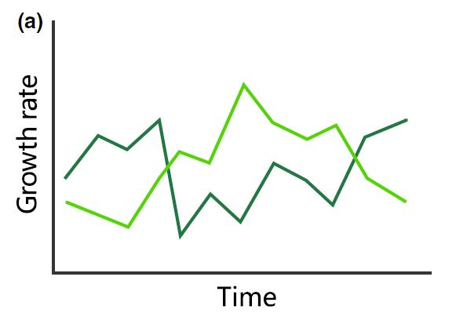
Effects of climate variability on :
Regional pool
1 – Local species pool ?
Environmental filtering
Local pool
2 – Species performance ?

Slide 60
1- Climate variability and local species pool

Slide 61
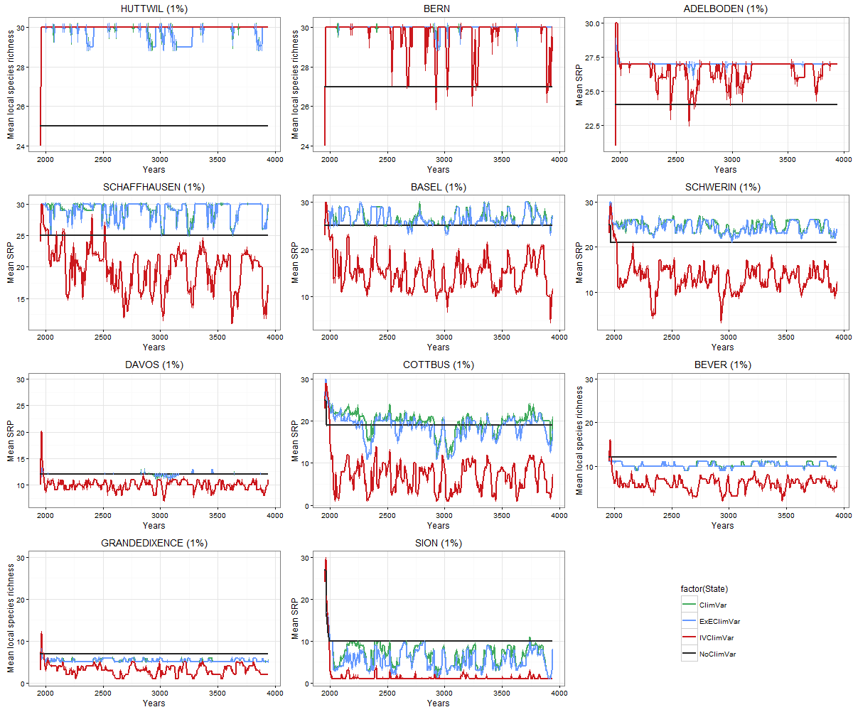
1- Climate variability and local species pool

Slide 62
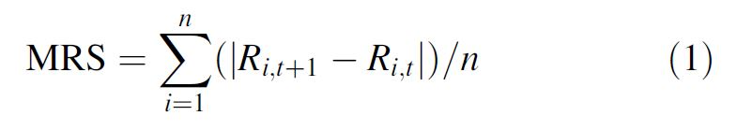
2- Climate variability and species performance
-> Mean Rank Shift (MRS)
Collins et al. 2008

Slide 63
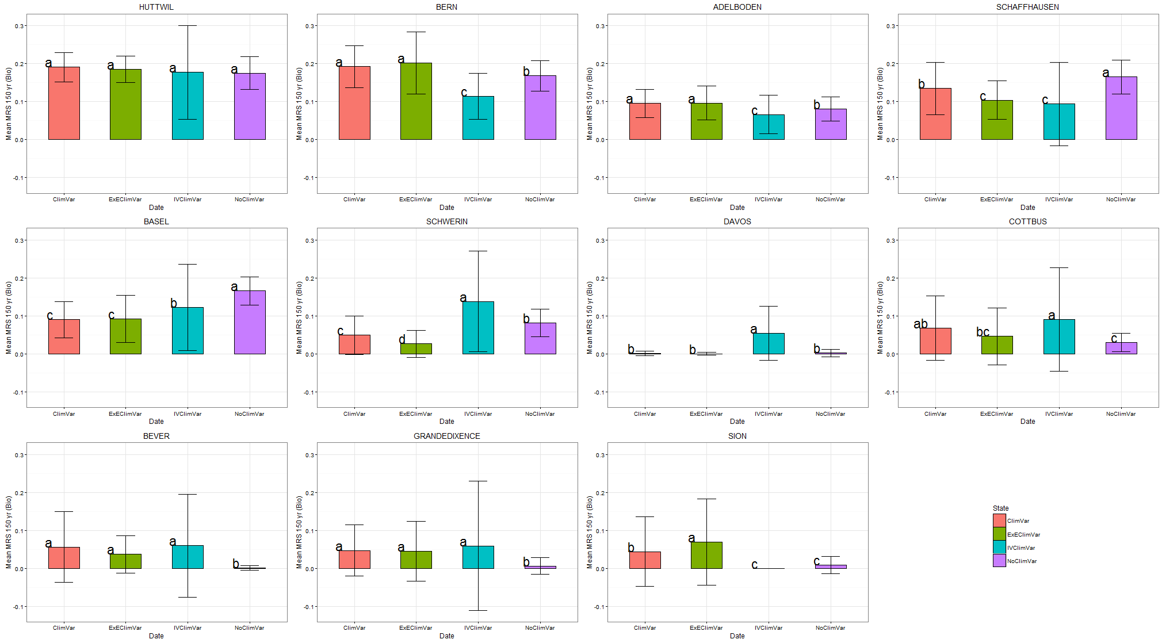
2- Climate variability and species performance

Slide 64
2- Climate variability and species performance
6/11 -> higher MRS (biomass based) with climate variability

Slide 65
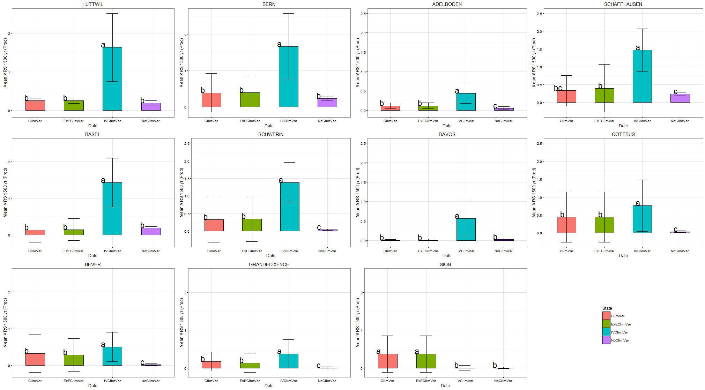
2- Climate variability and species performance
10/11 -> higher MRS (Productivity based) with increased climate variability
6/11 -> higher MRS (Productivity based) with standard climate variability

Slide 66

Climate variability and species turnover
Collins et al. 2008

Slide 67
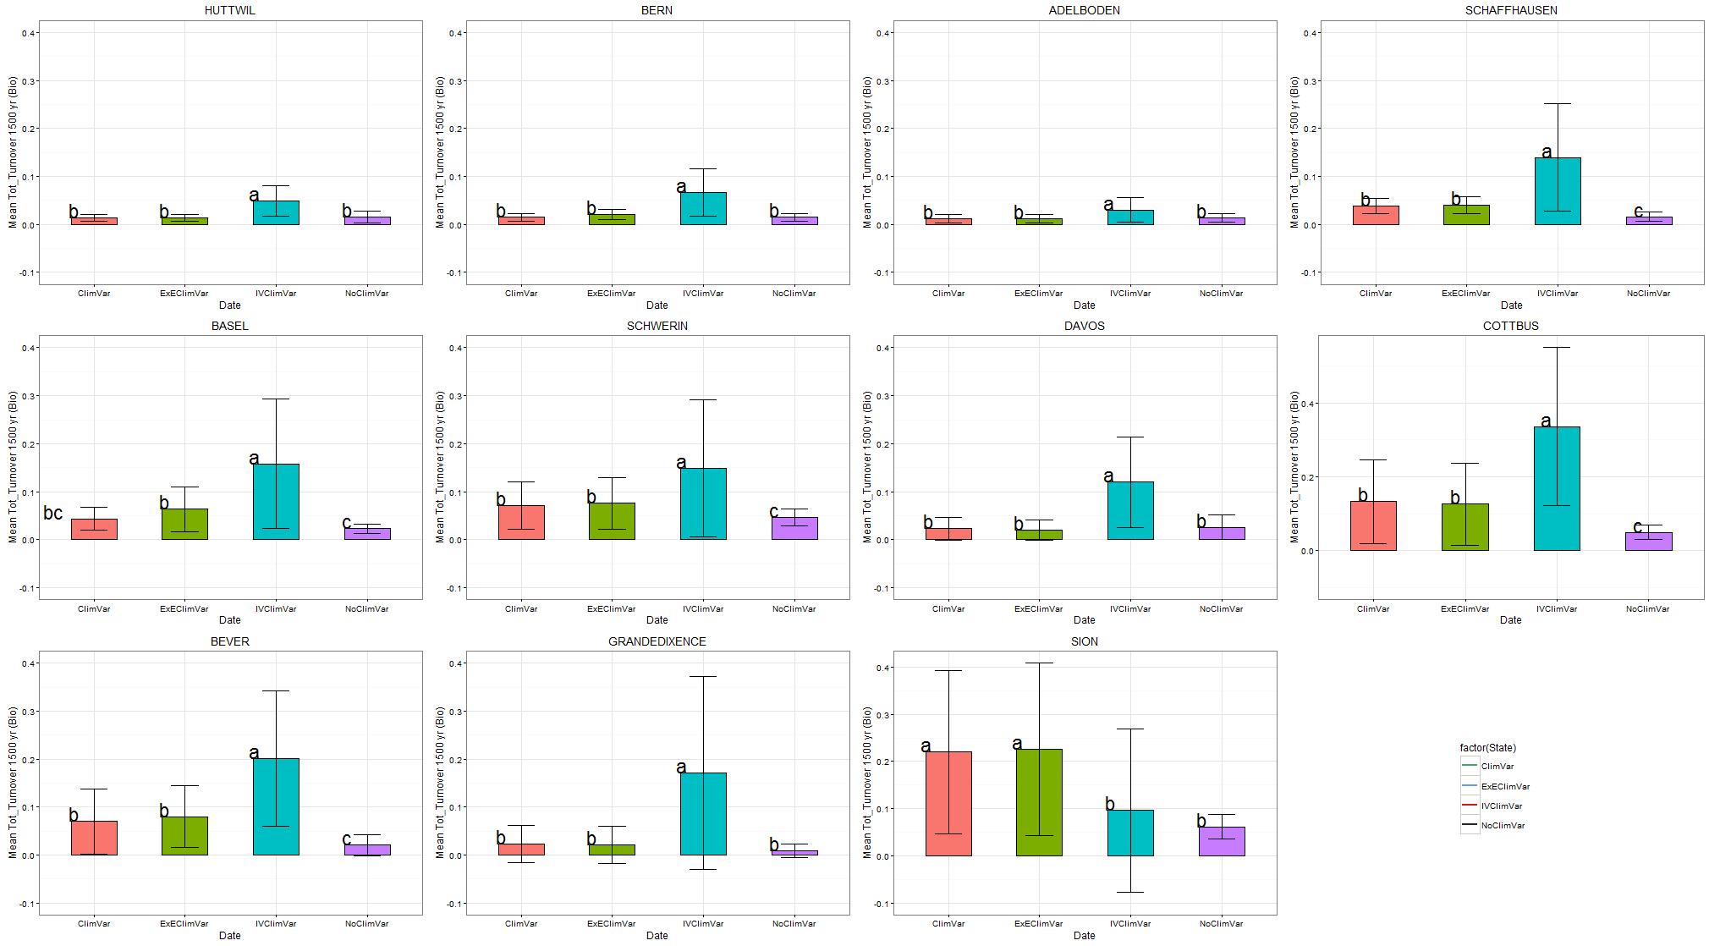
Climate variability and species turnover
10/11 -> higher turnover (biomass based) with increased climate variability
6/11 -> higher turnover (biomass based) with standard climate variability

Slide 68
Climate variability and community composition

Slide 69
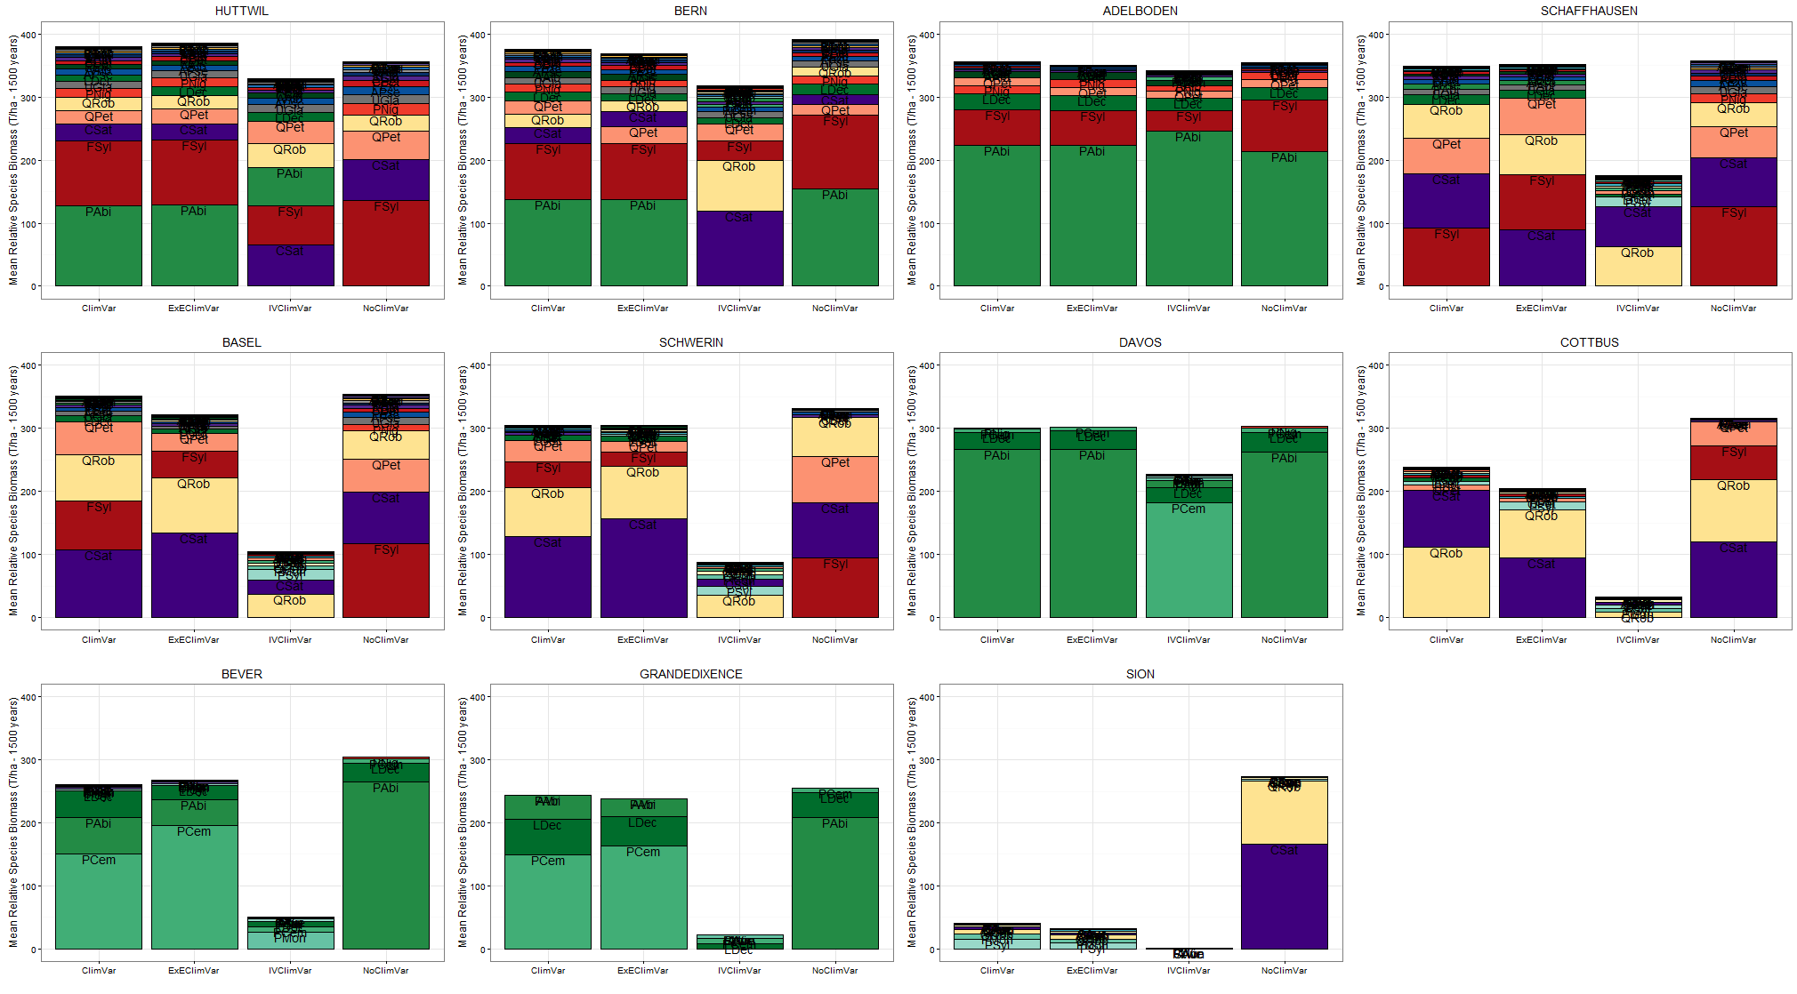
Climate variability and community composition
-> Strong impact of the climate variability on community composition

Slide 70
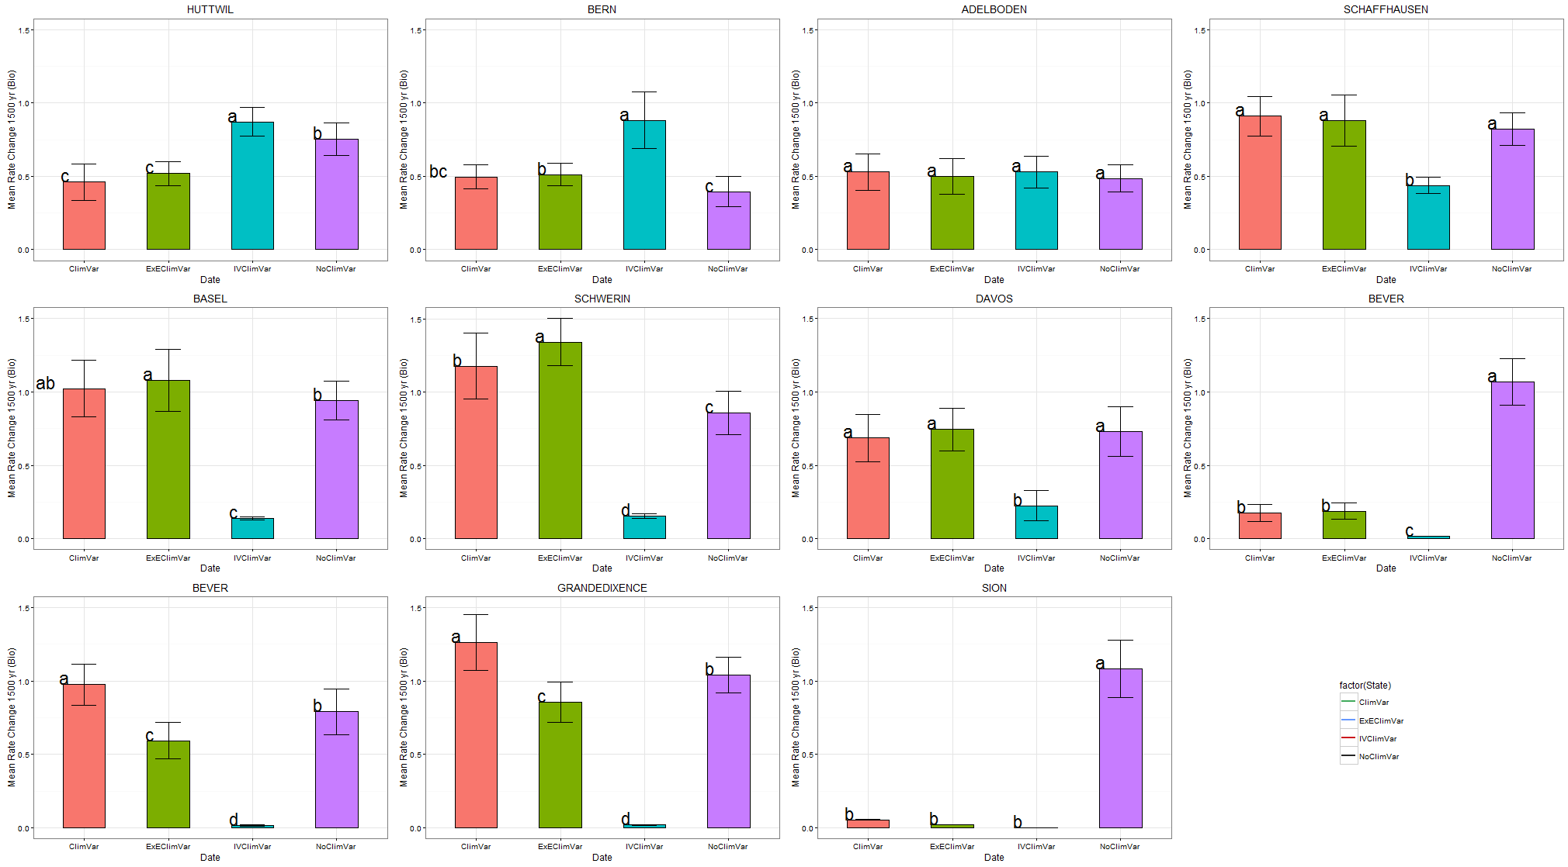
Climate variability and community composition

Slide 71
Climate variability and community composition
8/11 sites lower rate change with increased climate variability
-> slowing down the forest succession

Slide 72
Part 2 : To sum up
FORCLIM
Affect communities’ structure
(++ mean and maximal species richness)
Bugmann 2001
Temperature (°C) of May
Monthly means WITH interannual climate variability

Slide 73
Part 2 : To sum up
FORCLIM
Affect communities’ structure
(++ mean and maximal species richness)
Bugmann 2001
Temperature (°C) of May
Monthly means WITH interannual climate variability
1 - Local species richness (shift along the productivity gradient)

Slide 74
Part 2 : To sum up
FORCLIM
Affect communities’ structure
(++ mean and maximal species richness)
Bugmann 2001
Temperature (°C) of May
Monthly means WITH interannual climate variability
1 - Local species richness (shift along the productivity gradient)
2 - Change of the species performance
++ Species coexistence

Slide 75
Part 2 : To sum up
FORCLIM
Affect communities’ structure
(++ mean and maximal species richness)
Bugmann 2001
Temperature (°C) of May
Monthly means WITH interannual climate variability
1 - Local species richness (shift along the productivity gradient)
2 - Change of the species performance
3- Effects on the community composition and temporal shifts in the internal dynamics of communities
++ Species coexistence

Slide 76
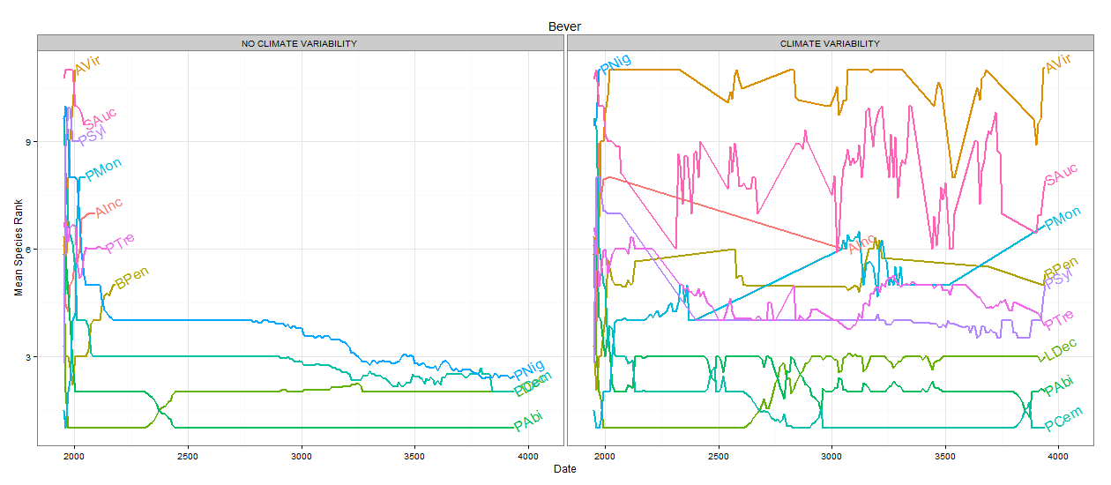
Species performance and climate variability
BEVER
Mean species rank

Slide 77
Species performance and climate variability
BEVER
Mean species rank

Slide 78
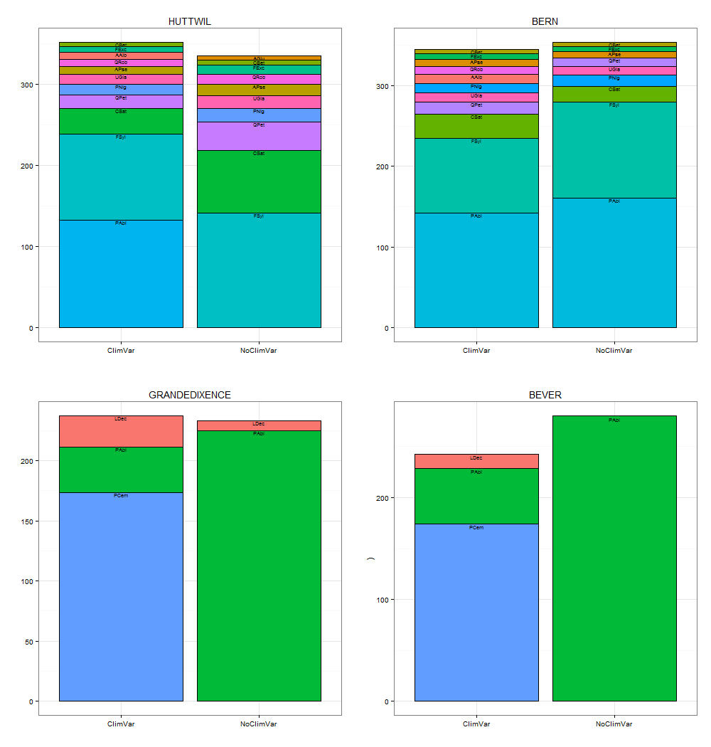
Species performance and climate variability
CSat
CSat
CSat
FSylv
FSylv
QPet
FSylv
CSat
FSylv
PAbi
PAbi
PAbi
Mean total biomass [t/ha] per species
Var
No Var
Var
No Var
LDec
LDec
PAbi
PAbi
PAbi
LDec
PAbi
PCem
PCem
Var
No Var
Var
No Var

Slide 79
Species performance and climate variability
CSat
CSat
CSat
FSylv
FSylv
QPet
FSylv
CSat
FSylv
PAbi
PAbi
PAbi
Mean total biomass [t/ha] per species
Var
No Var
Var
No Var
LDec
LDec
PAbi
PAbi
PAbi
LDec
PAbi
PCem
PCem
Var
No Var
Var
No Var

Slide 80
Part 2 : To sum up
FORCLIM
Affect communities’ structure
(local and realized species richness)
Bugmann 2001
Temperature (°C) of May
Monthly means WITH interannual climate variability

Slide 81
Part 2 : To sum up
FORCLIM
Affect communities’ structure
(local and realized species richness)
Bugmann 2001
Temperature (°C) of May
Monthly means WITH interannual climate variability
Change of the species performance
Species coexistence

Slide 82
Part 2 : To sum up
FORCLIM
Affect communities’ structure
(local and realized species richness)
Bugmann 2001
Temperature (°C) of May
Monthly means WITH interannual climate variability
Change of the species performance
Still PARTIALLY understood !!
Species coexistence

Slide 83
Part 2 : Perspective
FORCLIM
Properties aggregated at the whole forest scale
Bugmann 2001

Slide 84
Part 2 : Perspective
FORCLIM
Properties aggregated at the whole forest scale
Bugmann 2001
What about species coexistence within a single patch ?

Slide 85
THANKS FOR YOUR ATTENTION !

Slide 86
1
Analysis of abiotic and biotic community assembly processes
Climate variability, community assembly and species coexistence
2
3
Spatial scale, species assembly and coexistence

Slide 87
The patch: the fundamental unit of the forest dynamic

Slide 88
The patch: the fundamental unit of the forest dynamic
Patch 1
(X 20)
Mixtures
30 Species
…
Patch 2
…
2000 years
Patch 3
.....
Patch 10

Slide 89
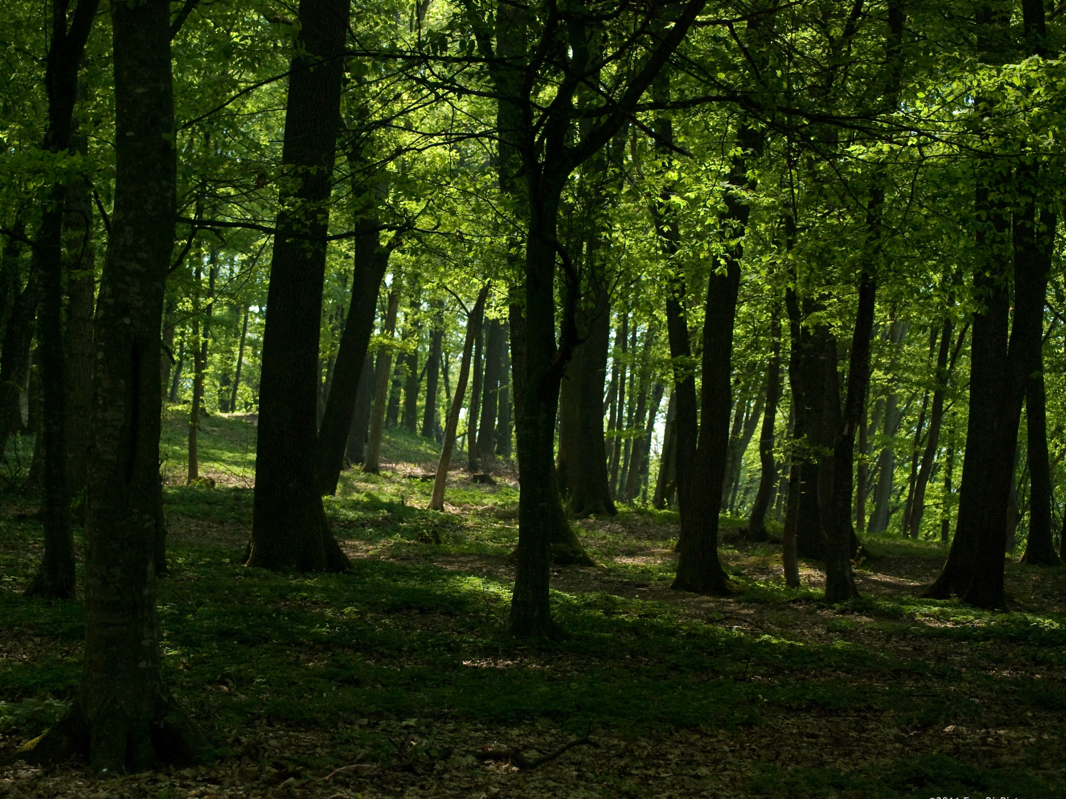
How do environmental conditions and competition affect forest structure at the patch scale ?

Slide 90
Species coexistence at the patch scale

Slide 91
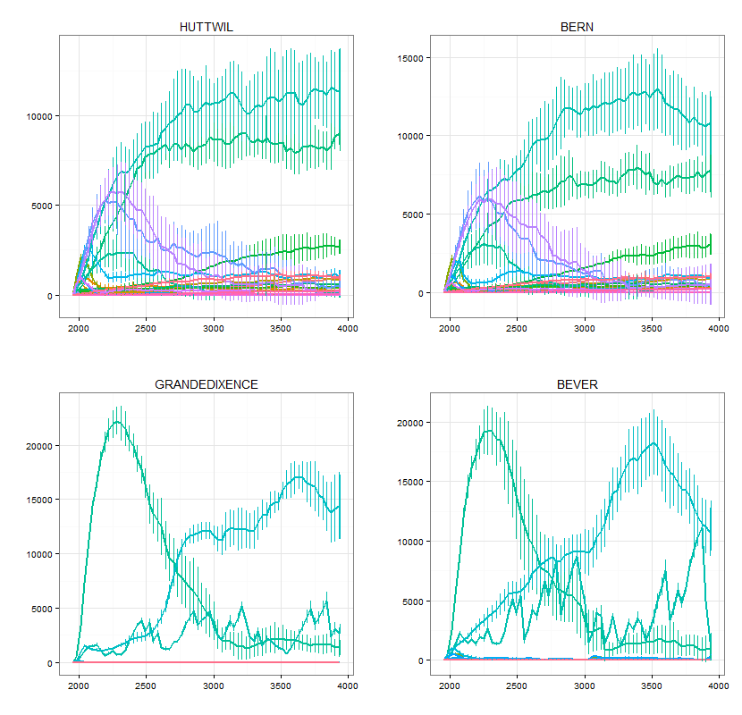
Species coexistence at the patch scale
Mean biomass (kg) per species

Slide 92
Species coexistence at the patch scale
Mean biomass (kg) per species

Slide 93
Species coexistence at the patch scale
Mean biomass (kg) per species

Slide 94
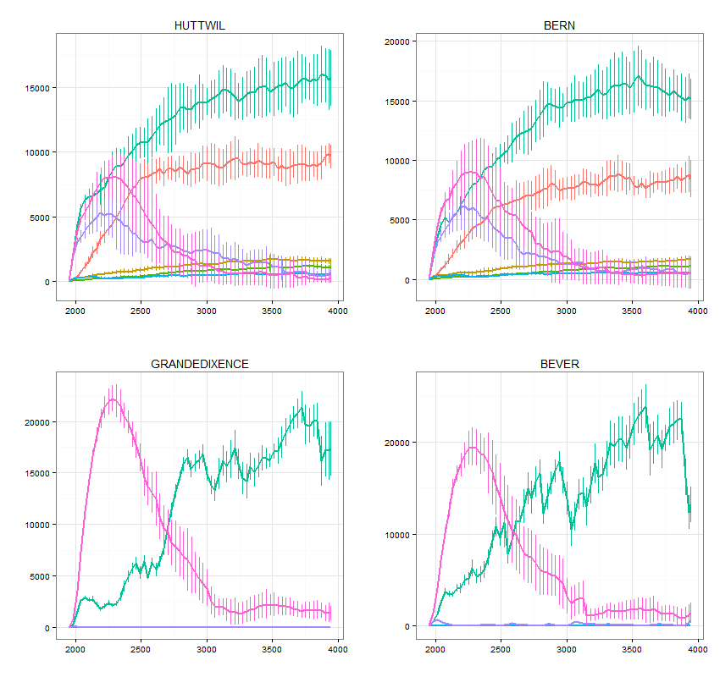

Species coexistence at the patch scale
ShTol
9
7
Mean biomass (kg) per species
6
5
4
3
1

Slide 95
Species coexistence at the patch scale
5
5
ShTol
9
9
9
7
Mean biomass (kg) per species
6
5
4
3
1

Slide 96
Species coexistence at the patch scale
5
5
ShTol
9
9
9
7
Mean biomass (kg) per species
6
5
1
4
5
1
5
3
1

Slide 97
Part 3: What next?
Functional structure of patches (CWM/CWV)
Patch 1

Slide 98
Part 3: What next?
Functional structure of patches (CWM/CWV)
Patch 1
Null
Communities (patch scale)
FORCLIM
Communities (patch scale)
VS
Frequency
Frequency
Trait axis
Trait axis

Slide 99
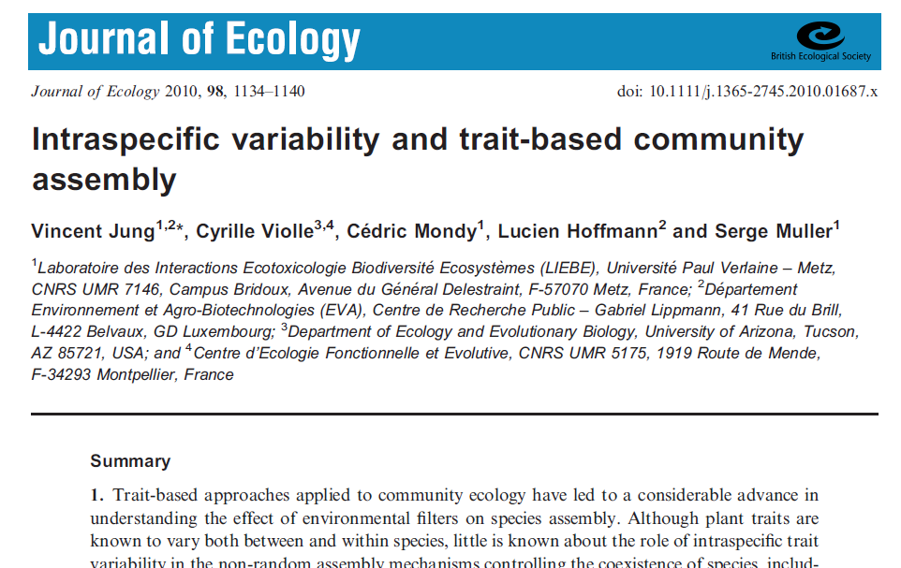
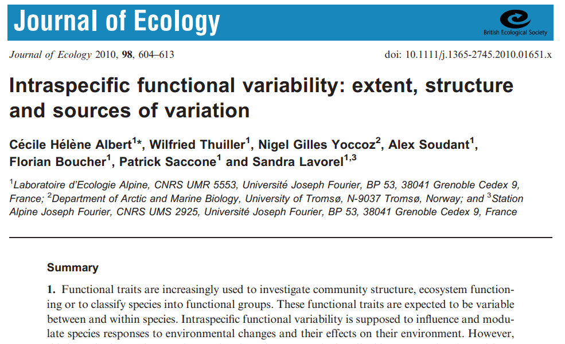
Part 3: Perspective

Slide 100
1
Analysis of abiotic and biotic community assembly processes
Climate variability, community assembly and species coexistence
2
3
Spatial scale, species assembly and coexistence
4
Intra-specific trait variability and forest structure

Slide 101


How to deal with intraspecific variability?
FORCLIM
Bugmann 2001
Species-based
Frequency
Trait axis
(According to Violle et al. 2012)

Slide 102
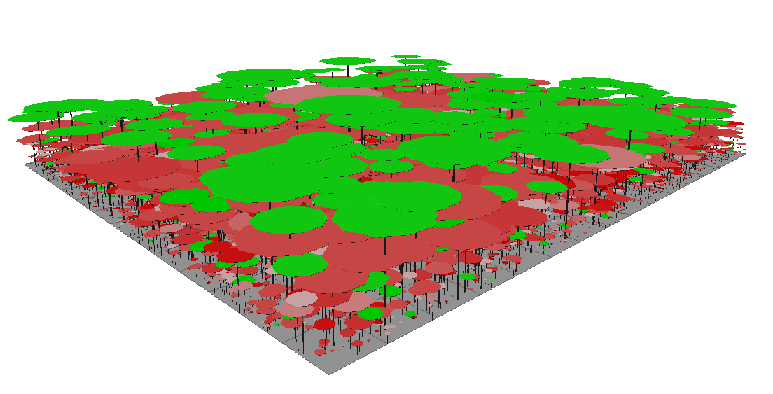
Development of a new forest model
FORCLIM
FORCEEPS
Bugmann 2001
Forest Community Ecology &
Ecosystem ProcesseS
Morin, Bugmann, Fahse & de Coligny (in prep.)
Species-based
Individual-based
Frequency
Frequency
Trait axis
Trait axis
(According to Violle et al. 2012)
(According to Violle et al. 2012)

Slide 103
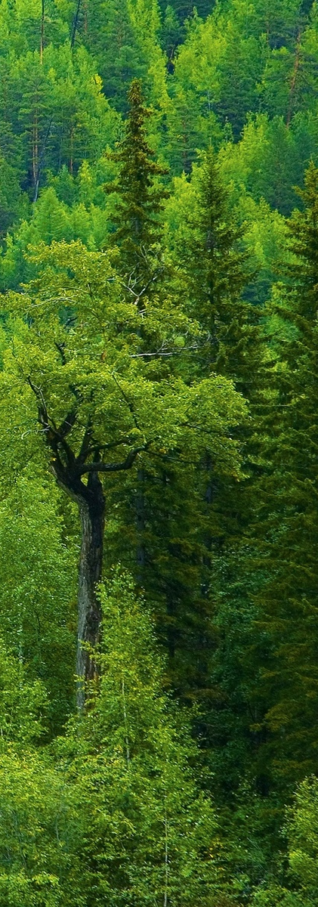
FORCEEPS validation
Currently for the 11 Swiss sites
FORCLIM
FORCEEPS
Biomass (T/ha)
Year
Year
Year
Year
Ex: Bern site
(100 patches, 1500 years)

Slide 104
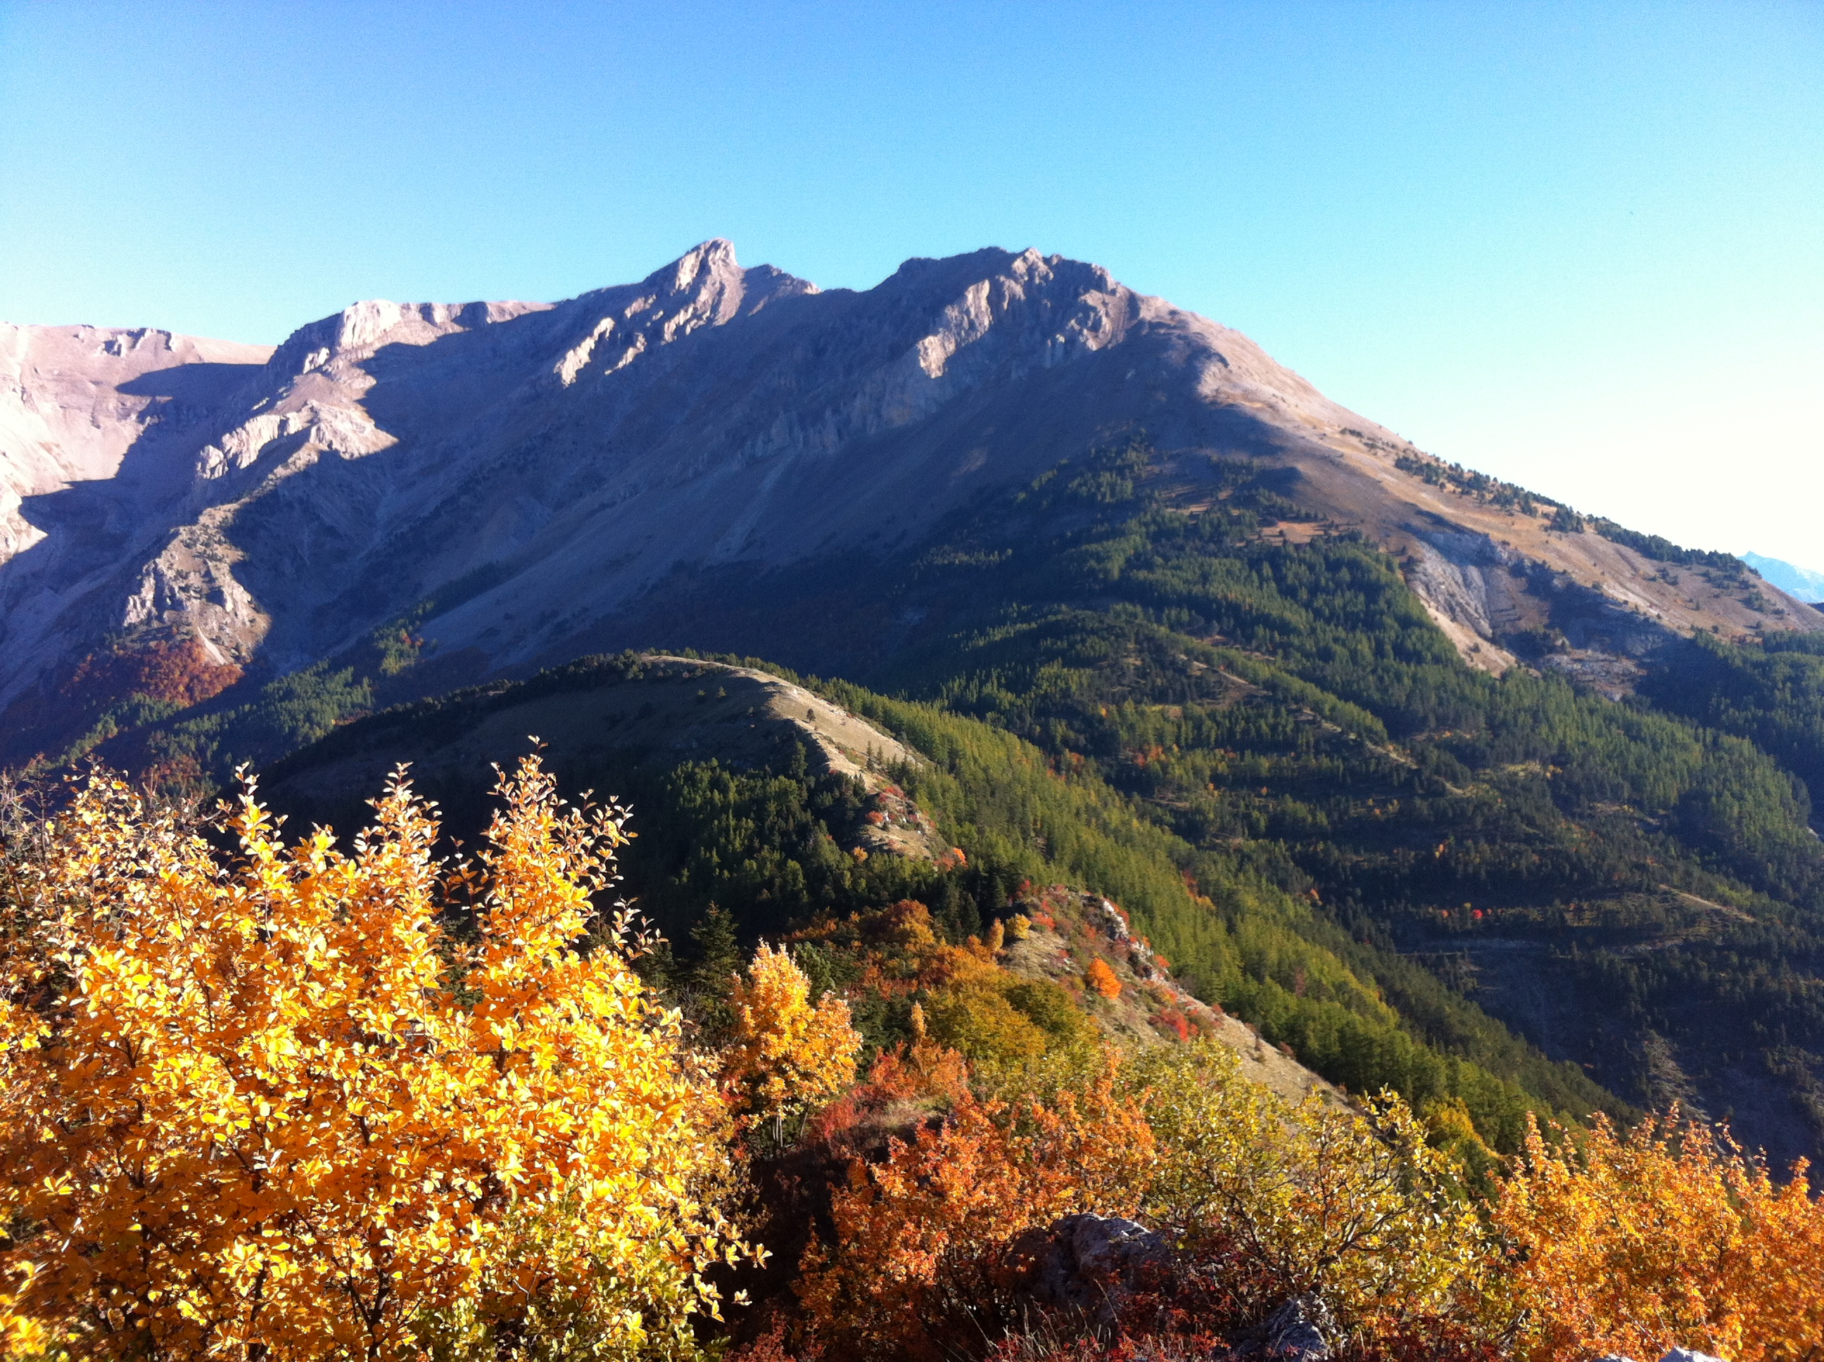
How does intra-specific trait variability affect forest communities assembly and tree coexistence ?

Slide 105
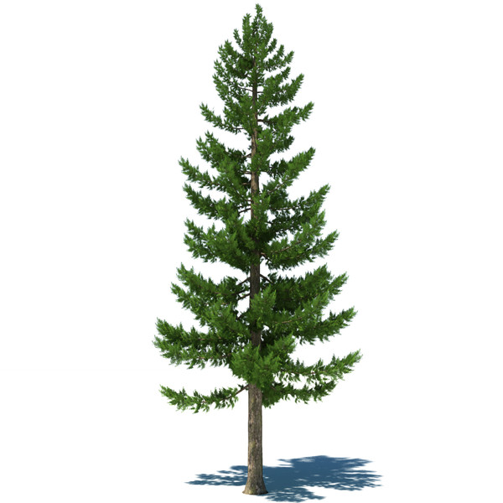
Simulations with intraspecific variability
At Bern site, with 8 species
5 genotypes per species differing in their shade tolerance (Sh_{Tol})
Sh_{Tol} = T avec T 1,..,9
Sh_{Tol} = T ± Ν(0,σ) avec σ = 1,2,3,4

Slide 106
Simulations with intraspecific variability
At Bern site, with 8 species
5 genotypes per species differing in their shade tolerance (Sh_{Tol})
Sh_{Tol} = T avec T 1,..,9
Sh_{Tol} = T ± Ν(0,σ) avec σ = 1,2,3,4
Monocultures
Mixtures
8 Species

Slide 107
Mixed forest biomass (T/Ha)...
σ = 0
σ = 1
σ = 4
σ = 3

Slide 108
…And monocultures productivity
Monocultures Productivity (T/ha/an)
σ
σ = 0
σ = 4

Slide 109

…And monocultures productivity
PRELIMINARY RESULTS…
…But intraspecific variability is an important driver for community composition and ecosystem functioning
Monocultures Productivity (T/ha/an)
σ
σ = 0
σ = 4

Slide 110
THANKS FOR YOUR ATTENTION !

Slide 111
Competition: trait divergence or convergence?
Env. stress
Maximal Age
Bazzaz 1979
Convergence
Frequency
Divergence
Trait axis
Frequency
Mayfield & Levine 2010
Trait axis
MacArthur & Levins 1967

Slide 112

FORCLIM Growth equation
Increment of the diameter at breast height (D):

Slide 113
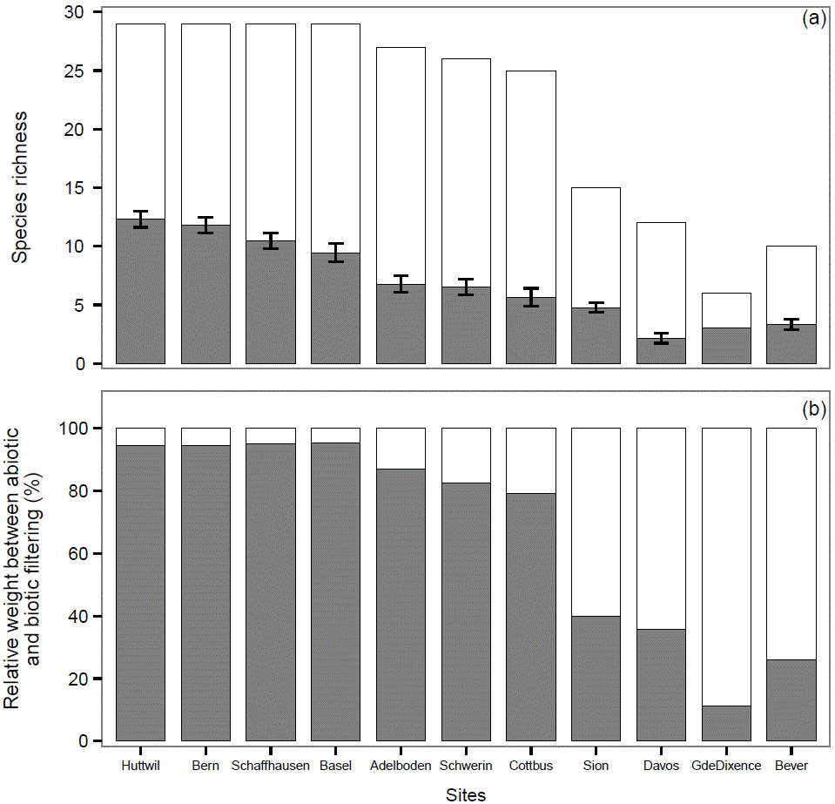
Species richness and environmental conditions
Potential Sp richness
Realized Sp richness
Environmental filter
Biotic filter
Chauvet et al. Submitted

Slide 114

Species trait correlations
ShTol
DDMin
DrTol
NTol
MinWit
MaxWit

Slide 115
Species trait correlations
 | kS | HMax | AMax | GwP | DDMin | WiTN | WiTX | DrTol | NReq | Brow | ShTol_{s} | ShTol
kS |  | 0.0476 | -0.3476 | 0.1283 | 0.1558 | -0.3268 | 0.2374 | -0.1340 | 0.2824 | -0.4571 | -0.1500 | -0.0606
HMax | 0.8026 |  | 0.5810 | 0.0832 | 0.0613 | 0.2972 | 0.0116 | -0.1388 | -0.0568 | 0.1255 | -0.2698 | -0.1806
AMax | 0.0598 | 0.0008 (***) |  | -0.4284 | 0.2544 | 0.3249 | -0.1627 | 0.1693 | -0.0229 | 0.3221 | -0.1719 | -0.2261
GwP | 0.4993 | 0.6619 | 0.0182 (*) |  | -0.2909 | -0.1630 | 0.1997 | -0.5620 | -0.1705 | -0.4862 | 0.2074 | 0.2757
DDMin | 0.4109 | 0.7476 | 0.1749 | 0.1189 |  | 0.0387 | 0.5716 | 0.1503 | 0.6061 | 0.0760 | -0.4925 | -0.4364
WiTN | 0.0780 | 0.1107 | 0.0798 | 0.3893 | 0.8390 |  | 0.0002 | -0.0896 | 0.0113 | 0.3384 | -0.3188 | -0.3994
WiTX | 0.2066 | 0.9513 | 0.3904 | 0.2899 | 0.0010 (**) | 0.9990 |  | -0.1222 | 0.3529 | -0.1583 | -0.2509 | -0.1756
DrTol | 0.4803 | 0.4646 | 0.3711 | 0.0012 (**) | 0.4280 | 0.6376 | 0.5200 |  | -0.2633 | 0.3774 | 0.3294 | 0.2865
NReq | 0.1305 | 0.7657 | 0.9044 | 0.3676 | 0.0004 (***) | 0.9529 | 0.0557 | 0.1598 |  | 0.0445 | -0.7262 | -0.6059
Brow | 0.0111 (*) | 0.5086 | 0.0826 | 0.0064 (**) | 0.6899 | 0.0674 | 0.4036 | 0.0398 (*) | 0.8155 |  | -0.1649 | -0.1337
ShTol_{s} | 0.4289 | 0.1494 | 0.3638 | 0.2715 | 0.0057 (**) | 0.0860 | 0.1812 | 0.0755 | 5.6E-06 (***) | 0.3838 |  | 0.9197
ShTol | 0.7506 | 0.3395 | 0.2295 | 0.1404 | 0.0159 (*) | 0.0288 (*) | 0.3532 | 0.1248 | 0.0004 (***) | 0.4812 | 7E-13 (***)

Slide 116
FORCLIM Growth equation
Increment of the diameter at breast height (D):
Growth rate parameter (constant)
Environment function
Establishment D
Diameter function

Slide 117

FORCLIM Growth equation
ƒ(e) = ?
Factors:
  light
  temperature
  drought
  nitrogen

Slide 118
Forest community assembly
Regional species pool
« The study of community ecology is in a state of flux, and will continue to be so until sufficient field data are available to test thoroughly the current theories and indicate in which direction new theories should go. » (Giller 1984)
?
Local community

